Slide 1


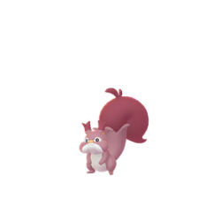
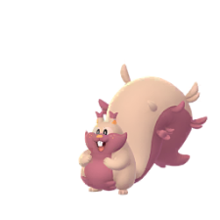
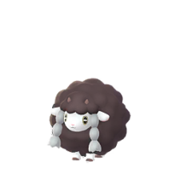
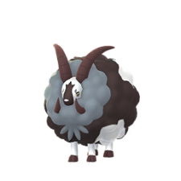
Pokemon Go : Shiny Check List
Generation 8 ( Galar )
Grookey
Thwackey
Rillaboom
Scorbunny
Raboot
Cinderace
NO SPRITE
NO SPRITE
NO SPRITE
NO SPRITE
NO SPRITE
NO SPRITE
Sobble
Drizzile
Inteleon
Skwovet
Greedent
Rookidee
NO SPRITE
NO SPRITE
NO SPRITE
NO SPRITE
Corvisquire
Corviknight
Blipbug
Dottler
Orbeetle
Nickit
NO SPRITE
NO SPRITE
NO SPRITE
NO SPRITE
NO SPRITE
NO SPRITE
Thievul
Gossifleur
Eldegoss
Wooloo
Dubwool
Chewtle
NO SPRITE
NO SPRITE
NO SPRITE
NO SPRITE
Drednaw
Yamper
Boltund
Rolycoly
Carkol
Coalossal
NO SPRITE
NO SPRITE
NO SPRITE
NO SPRITE
NO SPRITE
NO SPRITE
Applin
Flapple
Appletun
Silicobra
Sandaconda
Cramorant
NO SPRITE
NO SPRITE
NO SPRITE
NO SPRITE
NO SPRITE
More On Page 3
NO SPRITE
Page 1 of 4

Slide 2
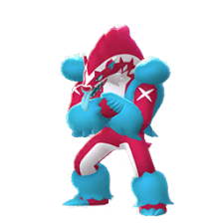
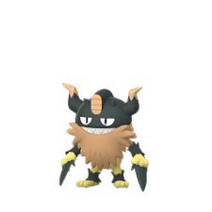
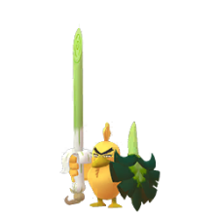
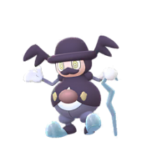
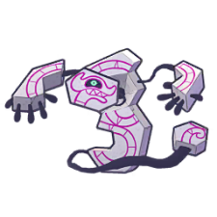
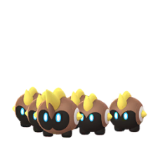
Pokemon Go : Shiny Check List
Generation 8 ( Galar )
Arrokuda
Barraskewda
Toxel
Toxtricity
Sizzlipede
Centiskorch
NO SPRITE
NO SPRITE
NO SPRITE
More On Page 3
NO SPRITE
NO SPRITE
NO SPRITE
Clobbopus
Grapploct
Sinistea
Polteageist
Hatenna
Hattrem
NO SPRITE
NO SPRITE
NO SPRITE
NO SPRITE
NO SPRITE
NO SPRITE
Hatterene
Impidimp
Morgrem
Grimmsnarl
Obstagoon
Perrserker
NO SPRITE
NO SPRITE
NO SPRITE
NO SPRITE
Cursola
Sirfetch'd
Mr. Rime
Runerigus
Milcery
Alcremie
NO SPRITE
NO SPRITE
More On Page 4
NO SPRITE
Falinks
Pincurchin
Snom
Frosmoth
Stonjourner
Eiscue
NO SPRITE
NO SPRITE
NO SPRITE
NO SPRITE
More On Page 3
NO SPRITE
Indeedee
Morpeko
Cufant
Copperajah
Dracozolt
Arctozolt
More On Page 3
More On Page 4
NO SPRITE
NO SPRITE
NO SPRITE
NO SPRITE
NO SPRITE
NO SPRITE
Page 2 of 4

Slide 3
Pokemon Go : Shiny Check List
Generation 8 ( Galar )
with Others
Dracovish
Arctovish
Duraludon
Dreepy
Drakloak
Dragapult
NO SPRITE
NO SPRITE
NO SPRITE
NO SPRITE
NO SPRITE
NO SPRITE
Zacian
Zamazenta
Eternatus
Kubfu
Urshifu
Zarude
NO SPRITE
NO SPRITE
NO SPRITE
NO SPRITE
NO SPRITE
NO SPRITE
More On Page 4
More On Page 4
More On Page 4
Regieleki
Regidrago
Glastrier
Spectrier
Calyrex
NO SPRITE
NO SPRITE
NO SPRITE
NO SPRITE
NO SPRITE
More On Page 4
Cramorant
Toxtricity
Normal
Gulping Form
Gorging Form
Amped Form
Low Key Form
NO SPRITE
NO SPRITE
NO SPRITE
NO SPRITE
NO SPRITE
Eiscue
Indeedee
Ice Face
Noice Face
Female
Male
NO SPRITE
NO SPRITE
NO SPRITE
NO SPRITE
Page 3 of 4

Slide 4
Pokemon Go : Shiny Check List
Generation 8 ( Galar )
Other’s
Alcremie
Vanilla
Cream
Ruby
Cream
Matcha Cream
Mint
Cream
Lemon
Cream
Salted
Cream
NO SPRITE
NO SPRITE
NO SPRITE
NO SPRITE
NO SPRITE
NO SPRITE
Ruby
Swirl
Caramel
Swirl
Rainbow
Swirl
Morpeko
NO SPRITE
NO SPRITE
NO SPRITE
Full Belly Mode
Hangry
Mode
NO SPRITE
NO SPRITE
Zacian
Zamazenta
Hero of Many Battles
Crowned Sword
Hero of Many Battles
Crowned Shield
NO SPRITE
NO SPRITE
NO SPRITE
NO SPRITE
Calyrex
Urshifu
Normal
Ice Rider
Shadow Rider
Single Strike Style
Rapid Strike Style
NO SPRITE
NO SPRITE
NO SPRITE
NO SPRITE
NO SPRITE
Page 4 of 4

